Slide 1
Jinan Acetate Acquisition of Cerdia
21 September 2026

Slide 2
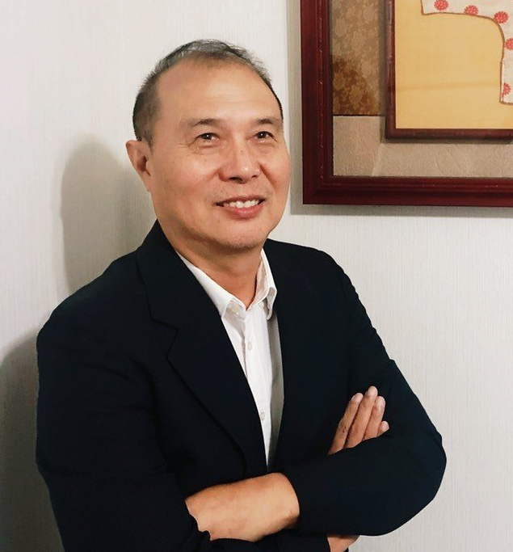
Executive Summary
“The transaction unites two highly complementary businesses, creating the leading global cellulose acetate products supplier with regional presence in all key markets. This allows us serving our global and local customer base with high manufacturing flexibility, regional proximity, advanced technical capabilities and the broadest product portfolio in the industry.”
Chairman Wang
A
    Establishing a clear leader in acetate products, uniting two of the industry's most established platforms with significantly enhanced global reach
B
    Highly complementary regional manufacturing footprints across Asia, Europe, US, Latin America and CIS, unlocking significant revenue growth and cost optimization opportunities for the combined platform
+
C
    Compelling industrial logic underpinning the transaction, delivering an enhanced customer offering alongside significant synergy potential across procurement, transportation and R&D
D
    A highly accretive transaction for shareholders, with 40%+ EPS accretion underscoring the compelling value creation potential of the combination

Slide 3

Creation of a Leading Filter Tow Player
A
    The combination of Jinan and Cerdia creates a global leader in acetate , with combined – LTM June’26 of ~USD 1bn and ~USD 400M EBITDA / 39% margin
    Two Established Industry Leaders with Differentiated Strengths
    Creating a Leading Global Player in Acetate products⁽¹⁾
    Jinan
    Vertically integrated acetate products leader with proprietary flake capacity (~70kt) and upstream integration
    Advanced production footprint in Shandong, China with ~770 skilled employees and 55kt filter tow
    Long-standing presence across Asia, Eastern Europe markets
    Jinan & Cerdia: Combined Pro Forma Financials – LTM June’26 ($m)
    Revenue
    EBITDA
    ~USD 1bn Combined Revenue
    ~USD 400M Combined EBITDA
    Cerdia
    Pure-play acetate tow manufacturer serving global majors and leading independents
    Sole player with a localized production base in Europe, CIS, Latin America and the U.S.
    High-quality, blue-chip customer base with long-term contracts and strong customer retention
Jinan
Jinan
Cerdia
Cerdia
    39% margin
    Transaction creates a globally scaled, vertically-integrated platform with enhanced manufacturing flexibility and customer relevance

Slide 4
Combined Assets Expand Global Footprint
B
    Compelling logic to combine highly complementary manufacturing footprints across Asia, Europe, the US and Latin America
    New Company Pro-Forma Filter Tow Production
    Jinan & Cerdia: Nameplate Capacity
 | Acetate Tow | Acetate Flake
Asia | ~55kt | ~70kt
Europe | ~75kt | ~45kt
North America | - | ~80kt
Latin America | ~19kt | -
CIS | ~15kt | -
Combined | ~164kt | ~195kt
    Operated in full compliance with all applicable regulation
Serpukhov (filter tow)
Freiburg (filter tow and flake)
Kingsport (flake)
Basel
Dezhou (flake
& cellulose anhydride)
Shandong
Jinan (acetate tow)
Shandong
Taipei
City
Zaozhung (acetate flake & cellulose anhydride)
Santo André (filter tow)
    Combination creates the global #1 player
Cerdia’s Headquarter
Jinan’s Stock Listing
Cerdia’s Manufacturing Base
Jinan’s Manufacturing Base

Slide 5




Strong Industrial Logic
C
    The combination of Jinan and Cerdia is underpinned by a compelling industrial logic and significant value-creation potential
    Revenue Synergies
    Highly complementary customer base and geographic footprint
    The combination creates the leading global acetate player, with a dedicated pure-play focus and substantial opportunities to capture additional market share
    Cost Synergies
    Mutual use of global production facilities across Cerdia and Jinan, optimizing logistics costs and enhanced supply chain through local production and customer intimacy
    Procurement economies of scale
    Technology & Supply Chain
    Combination of technical and manufacturing expertise across both platforms
    Optimization of supply chain networks, enhancing efficiency, reliability and product offering for customers
    Stakeholder Benefits
    Shareholders benefit from enhanced earnings potential, customers from global manufacturing footprint and advanced technical expertise, and employees from attractive growth opportunities

Slide 6
Transaction Terms
D
    Highly accretive transaction for Jinan’s shareholders
    Terms of the Transaction
    Issuance of ~10% new Jinan shares to Cerdia’s shareholders (for ~40% equity in Cerdia).
    $0.2bn cash (for ~60% equity in Cerdia)
    Roll of $0.7bn of the Cerdia's existing Corporate Bond (expected to meet bond portability conditions).
    Jinan operations are fully shielded from the bond, with security pledged exclusively by Cerdia’s assets
    The transaction is expected to close early 2027, and is subject to the customary anti-trust and regulatory approvals
    Expected Financial Benefits
    Significant cost synergies expected from the transaction
    The transaction would have been more than 40% accretive to Jinan’s LTM June 2026 EPS before synergies

